Slide 1


Slide 2
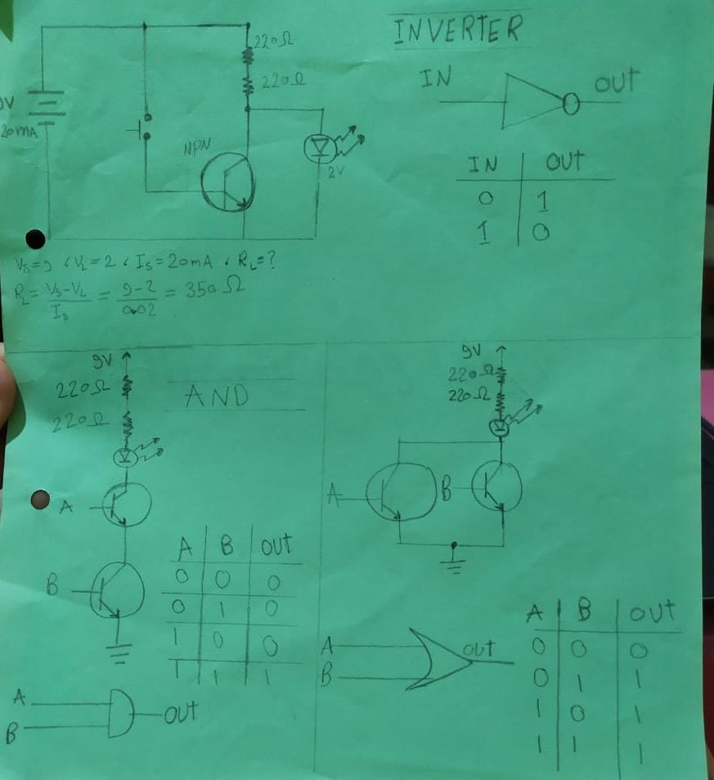
9V
20A

Slide 3
This should of be the circuit of the AND, OR, NOT gates using transistors and buttons
when I applied It the NOT gate worked but the AND,OR there was something wrong
I was not able detect if I wrongly connected the wires or the circuit is wrong I asked some
People who I know but they did not give me a direct answer ,but do not worry inshallah I
Will be able to find it willy nilly.
I tried to write a code for the truth table using assembly
but I just made it in two variables in case you are wondering why the three variables does
not work

